Slide 1
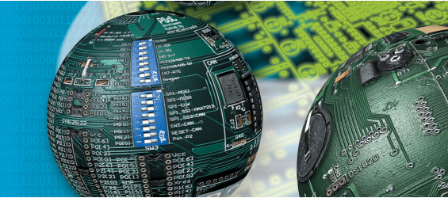
Embedded Systems systick timer + PLL
Fall 2018
NUCES – FAST

Slide 2
SysTick Timer
Timer/Counter operation
24-bit counter decrements at bus clock frequency
With 80 MHz bus clock, decrements every 12.5 ns
Counting is from n → 0
Setting n appropriately will make the counter a modulo n+1 counter. That is:
next_value = (current_value-1) mod (n+1)
Sequence: n,n-1,n-2,n-3… 2,1,0,n,n-1…
Notes:
Modulo (mod or %) operation gives the remainder: (a mod n) is the remainder when a is divided by n.
When a < n, (a mod n) is simply a.
When current_value reaches 0, then the next value is [(0-1)mod (n+1)] = -1 mod (n+1) = n
That is the counter gets reset to max value n after it reaches 0.

Slide 3
SysTick Timer
Initialization (4 steps)
Step1: Clear ENABLE to stop counter
Step2: Specify the RELOAD value
Step3: Clear the counter via NVIC_ST_CURRENT_R
Step4: Set NVIC_ST_CTRL_R
CLK_SRC = 1 (bus clock is the only option)
INTEN = 0 for no interrupts
ENABLE = 1 to enable
Notes:
RELOAD value is the value to load into the counter (reset) every time it hits zero, i.e. the n value from the previous slide

Slide 4
SysTick Timer in C
void SysTick_Init(void)
{
NVIC_ST_CTRL_R = 0; // 1) disable SysTick during setup
NVIC_ST_RELOAD_R = 0x00FFFFFF; // 2) maximum reload value
NVIC_ST_CURRENT_R = 0; // 3) any write to CURRENT clears it
NVIC_ST_CTRL_R = 0x00000005; // 4) enable SysTick with core clock
}
// The delay parameter is in units of the 16
//MHz core clock(62.5 ns)
void SysTick_Wait(uint32_t reloadvalue)
{
NVIC_ST_RELOAD_R = reloadvalue-1; // number of counts
NVIC_ST_CURRENT_R = 0; // any write to CURRENT clears it
while((NVIC_ST_CTRL_R&0x00010000)==0) //polling 16th bit of NVIC_ST_CTRL_R
{
// wait for flag
}
// Call this routine to wait for delay*500us
void SysTick_Wait500us (uint32_t delay)
{
unsigned long i;
for (i=0; i<delay; i++)
{
SysTick_Wait(8000); // wait 500us for a crystal of 16MHz
// n = 8000
}
}

Slide 5
Phase Locked Loop - PLL
Allows the software to adjust the execution speed of computer
Choice of frequency involves tradeoff between software execution speed and electrical power
Slowing down the bus clock will require less power to operate and generate less heat

Slide 6
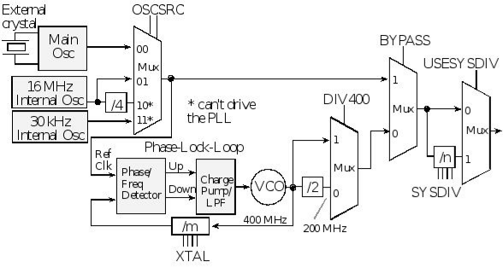
Phase Locked Loop (PLL)
Sysdiv = 7 bits
Clock is divided by n+1, for example, to get 80MHz from 400MHz PLL, we need to divide by 5 so n = 4

